Slide 1


Online Investments Tool for FY 2014-15
Payroll Team
April 2014

Slide 2
Features of online tool
  The on-line tool will help you to update your proposed Investment plan and actual investment proof submission for the Financial Year 2014-2015
  The proposed investment details needs to be updated by you during the beginning of the Financial Year and can be changed whenever you want to change your Investment Plan
  Medical , Telephone, Fuel, Driver salary and LTR bills needs to be submitted along with the claim form as and when the employee incurs the expenditure after updating the link
  It also help you to know the current status of your claims on-line (i.e. whether its under process or accepted or not accepted for want of clarification, etc)
  All the details updated on or before 15th of every month will be considered in the same month payroll process, else would be considered in next month payroll

Slide 3
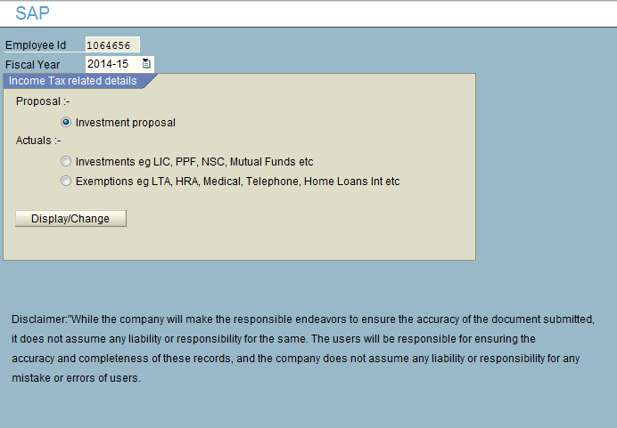
Investment proposal
Step 1
Click on the Investment proposal
Step 2
Click on Display / Change Button
( This will take you to the next screen )

Slide 4
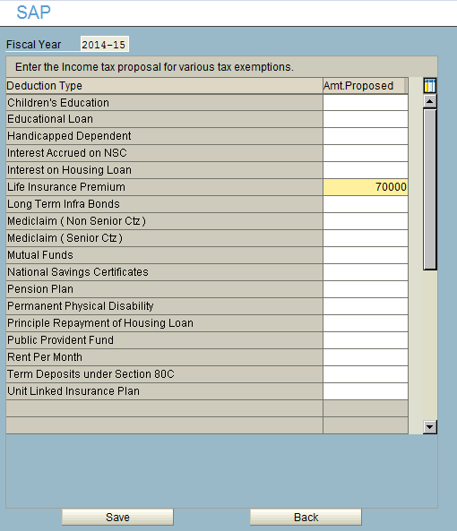
Investment proposal contnd..
Step 1
Select the type of investment under Which you would like to invest
Step 2
Enter the correct amount
Step 3
Click on the Save Button to see the following message

Slide 5
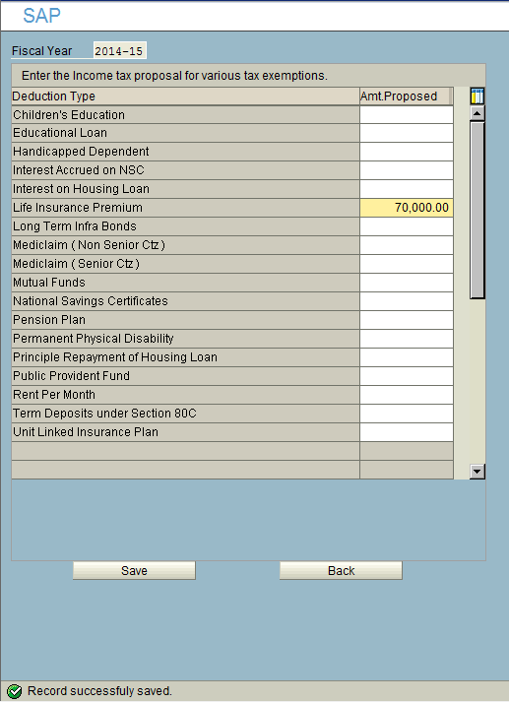
Investment proposal contnd..
Your proposed Investment
Plan for the year 2014-15
has been updated

Slide 6
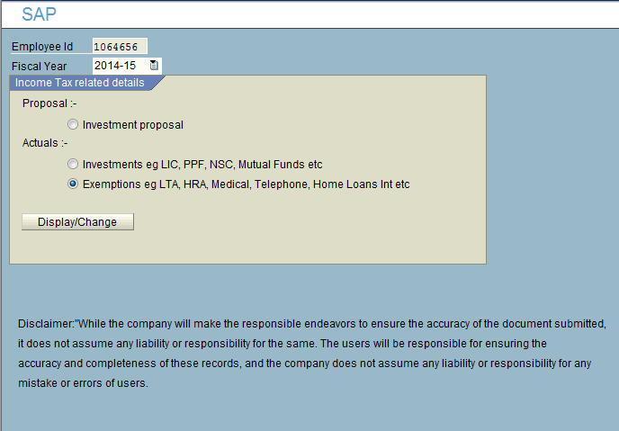
Process to update on tool for reimbursement Claims
Step 1
Click on the Actuals
(For Medical Telephone and LTR )
Step 2
Click on Display / Change Button
( This will take you to the next screen )

Slide 7
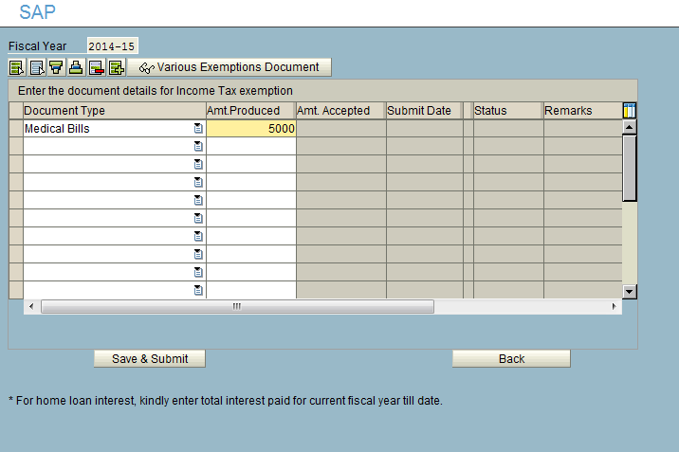
Submission of Medical ,Telephone, HRA and LTR
Step 1
Select the component that you would Like to submit ( Ex: Medical bills, Telephone Bills etc )
Step 2
Enter the amount
Step 3
Click on Save and Submit button
Step 4
Download the Claim form from the
Portal, attach the original bills and send it across to Finance

Slide 8
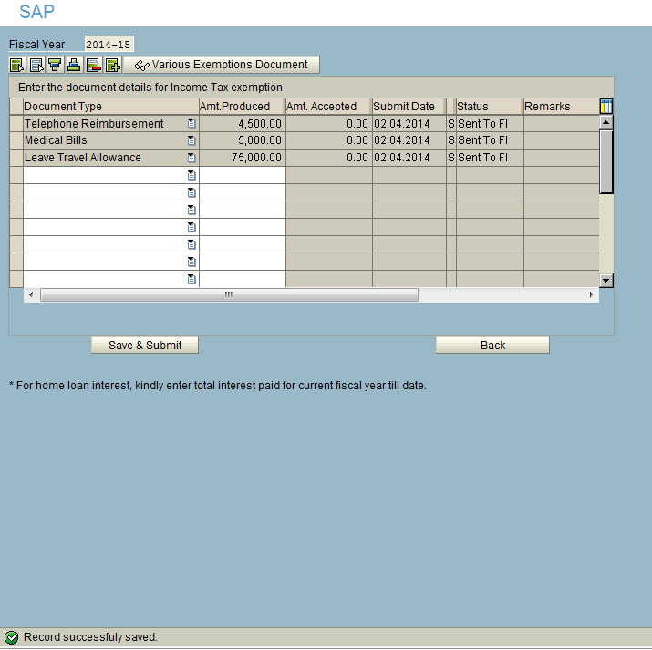
Submission of Medical ,Telephone, HRA and LTR
Step: 5
Ensure that the status is “ Sent to FI”.
Step:6
Ensure that the record is saved.

Slide 9
Thank You!
E-mail – hrdirectapj@sap.com

